Slide 1
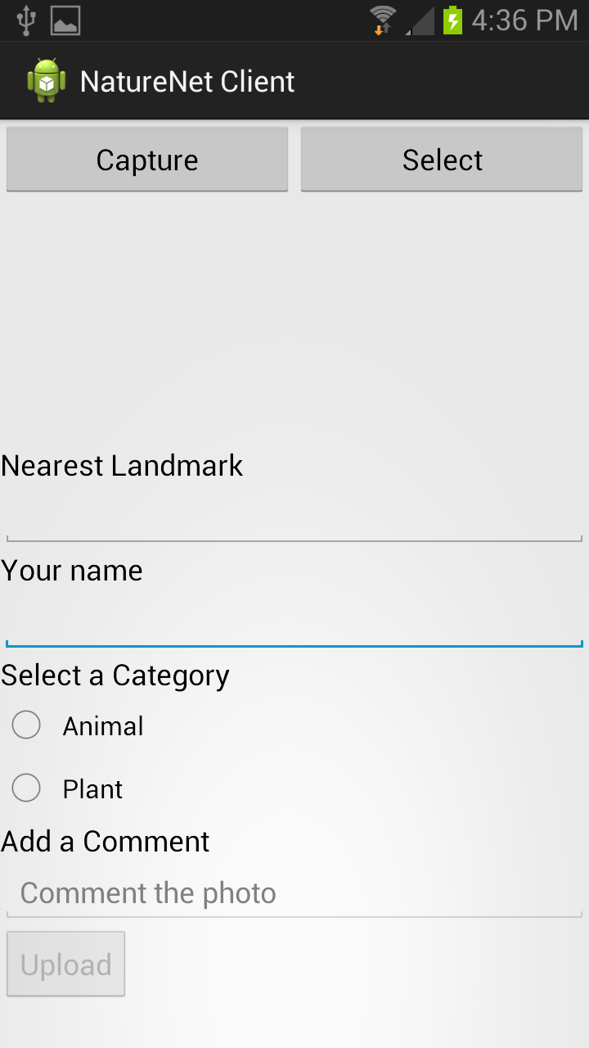
Main Screen
A uses can “capture” a new photo or “select” an existing photo stored on the device.
In this demo, the user chooses to “Capture” a new photo.

Slide 2
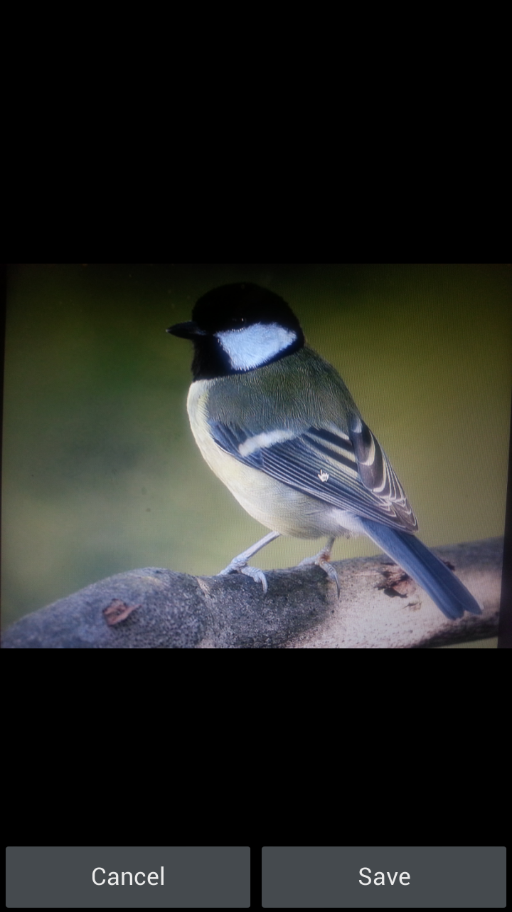
Camera
The user uses the built-in camera to capture a photo.

Slide 3
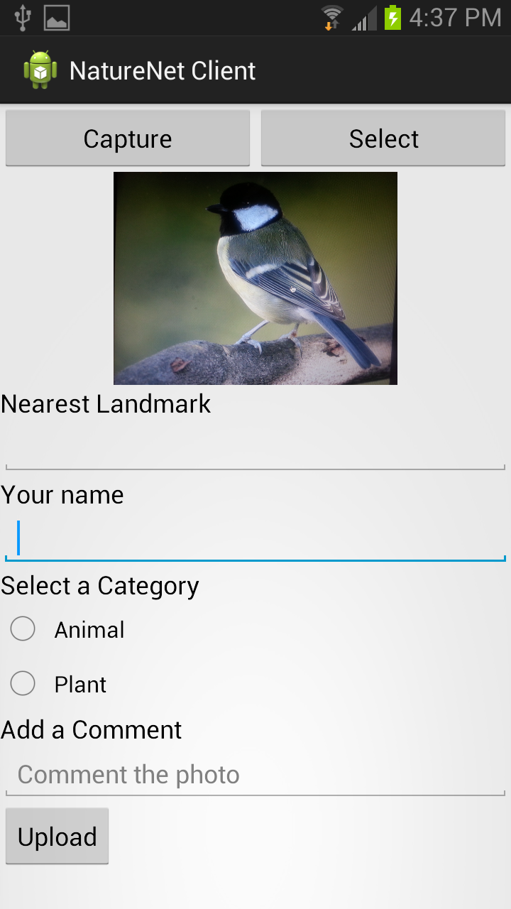
Main Screen (+ photo)
After a new photo is captured, the user sees the captured photo shown in the main screen.
The user touches the “Nearest Landmark” field to see the next screen.

Slide 4
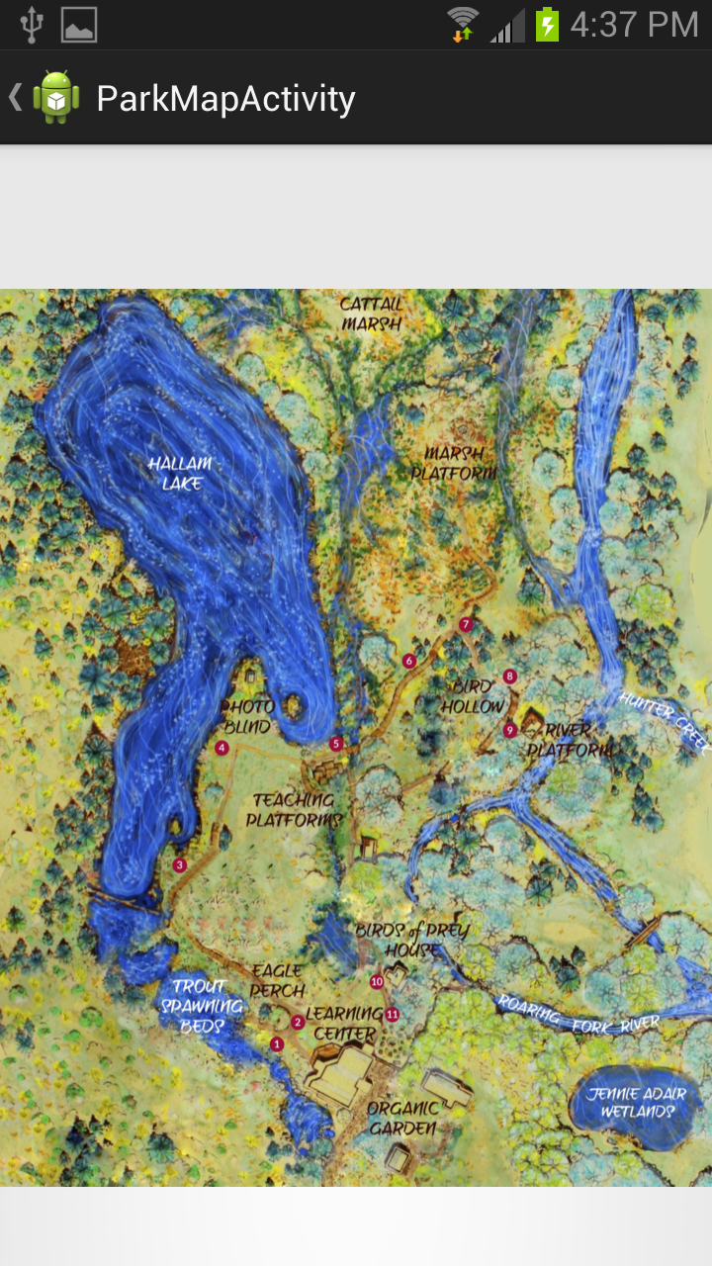
Park Map
The user can see the map of the park.

Slide 5
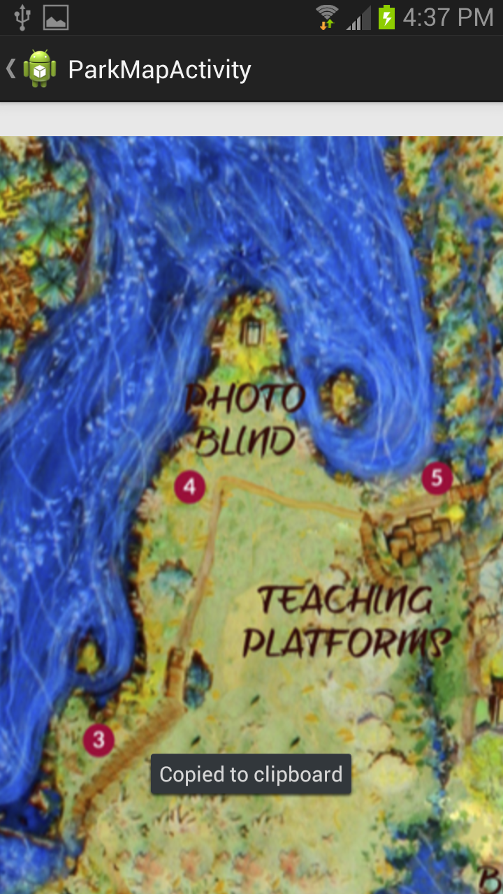
Park Map
The user can pitch zoom.

Slide 6
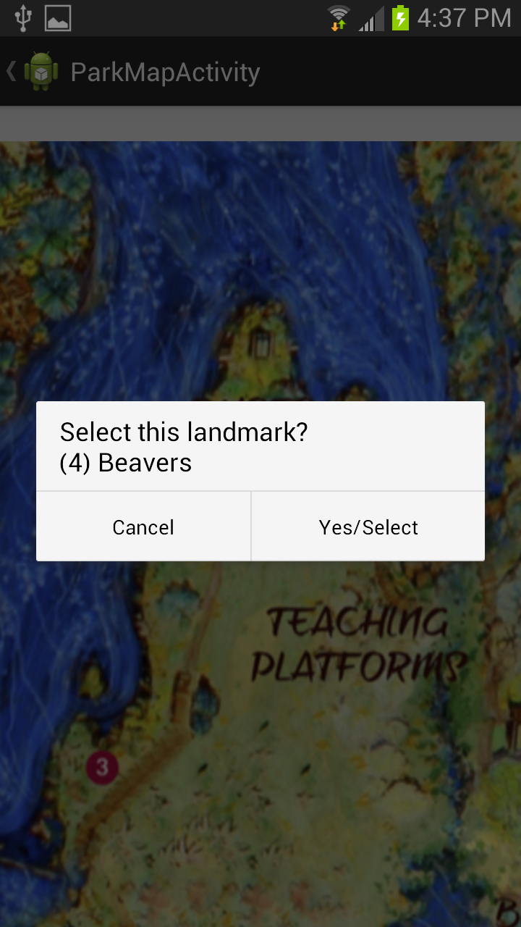
Park Map
The user touches the number 4. A dialog box pops up to confirm the selection.

Slide 7
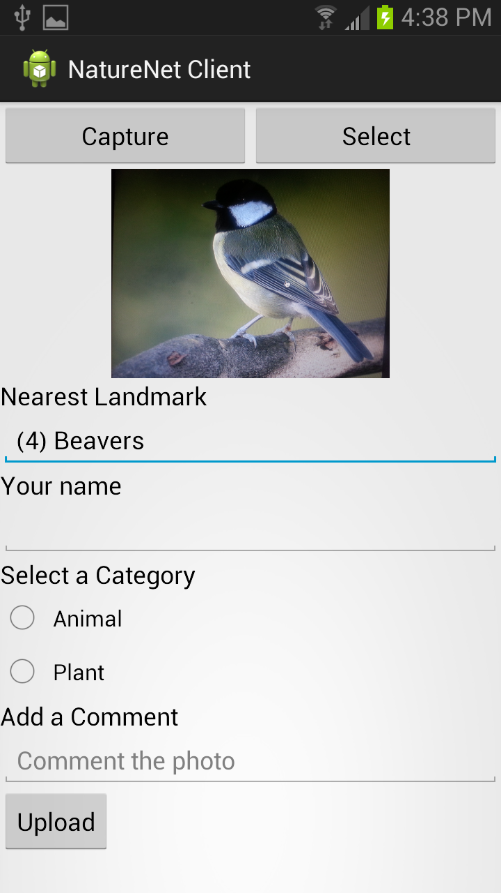
Main Screen
The selected landmark’s name is displayed.

Slide 8
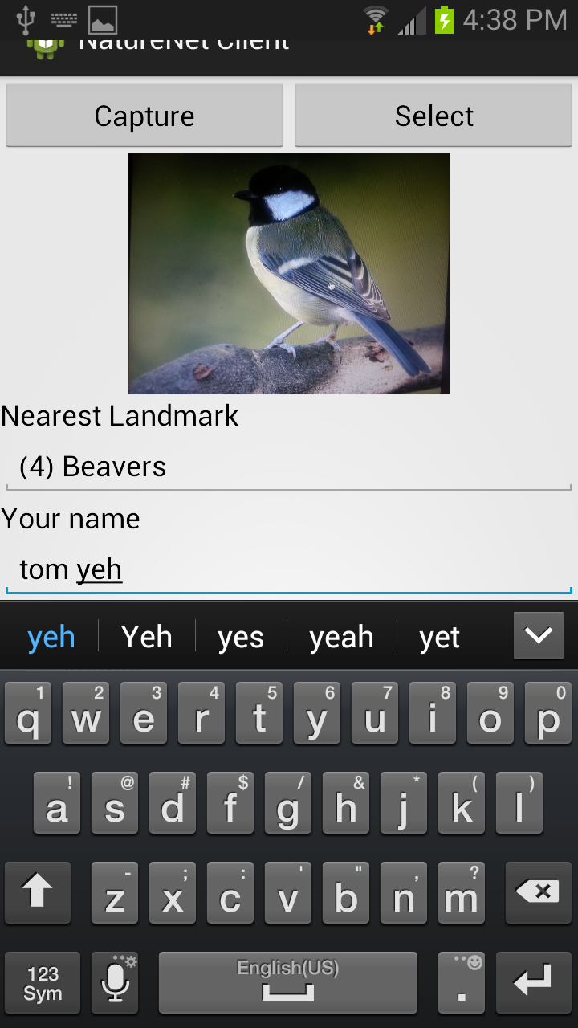
Main Screen
The user can enter his/her name.

Slide 9
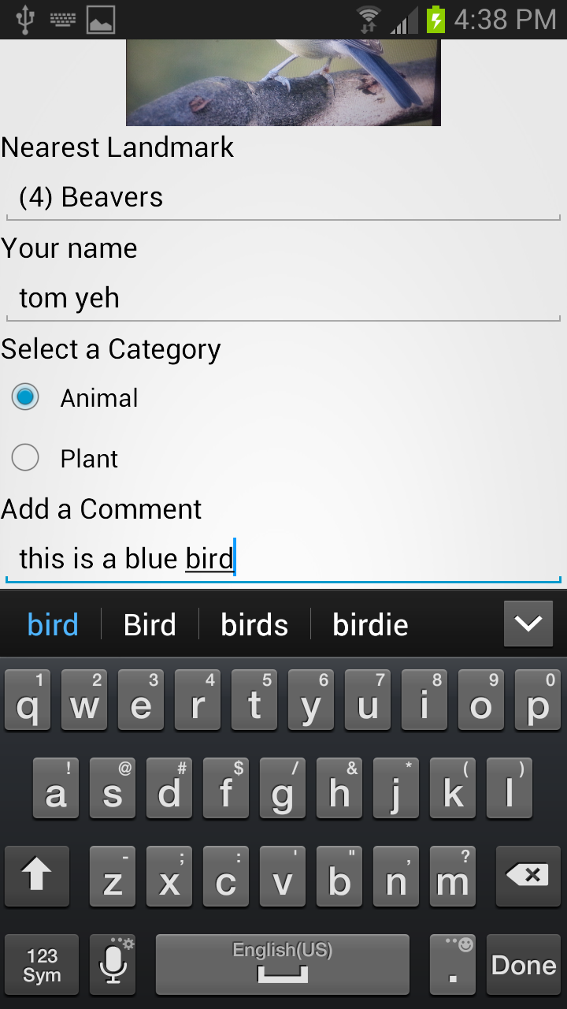
Main Screen
The user selects a category and adds a comment.

